Slide 1
Phasor measurement unit
Muhammed Hosni AbdelAzem

Slide 2
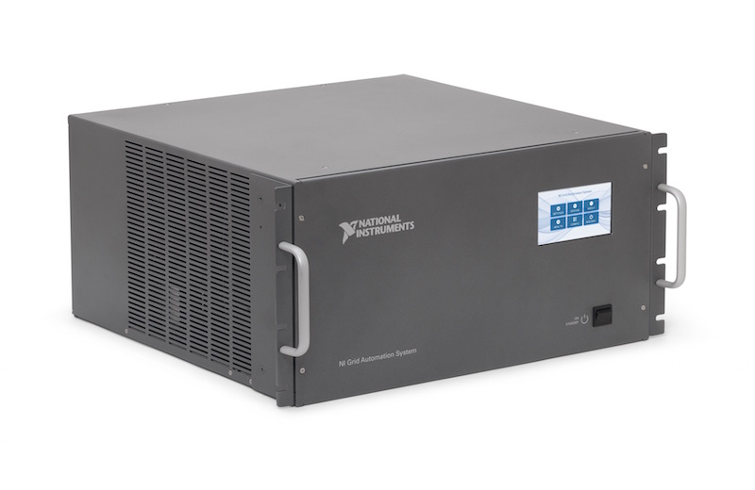
PMU:
Def :A phasor measurement unit (PMU) is a device used to estimate the magnitude and phase angle of an electrical phasor quantity (such as voltage or current) in the electricity grid using a common time source for synchronization. Time synchronization is usually provided by GPS and allows synchronized real-time measurements of multiple remote points on the grid. PMUs are capable of capturing samples from a waveform in quick succession and reconstructing the phasor quantity, made up of an angle measurement and a magnitude measurement. The resulting measurement is known as a synchrophasor. These time synchronized measurements are important because if the grid’s supply and demand are not perfectly matched, frequency imbalances can cause stress on the grid, which is a potential cause for power outages.
PMUs can also be used to measure the frequency in the power grid. A typical commercial PMU can report measurements with very high temporal resolution in the order of 30-60 measurements per second. This helps engineers in analyzing dynamic events in the grid which is not possible with traditional SCADA measurements that generate one measurement every 2 or 4 seconds. Therefore, PMUs equip utilities with enhanced monitoring and control capabilities and are considered to be one of the most important measuring devices in the future of power systems. A PMU can be a dedicated device, or the PMU function can be incorporated into a protective relay or other device.

Slide 3
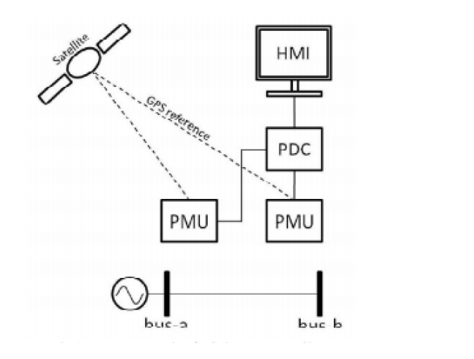
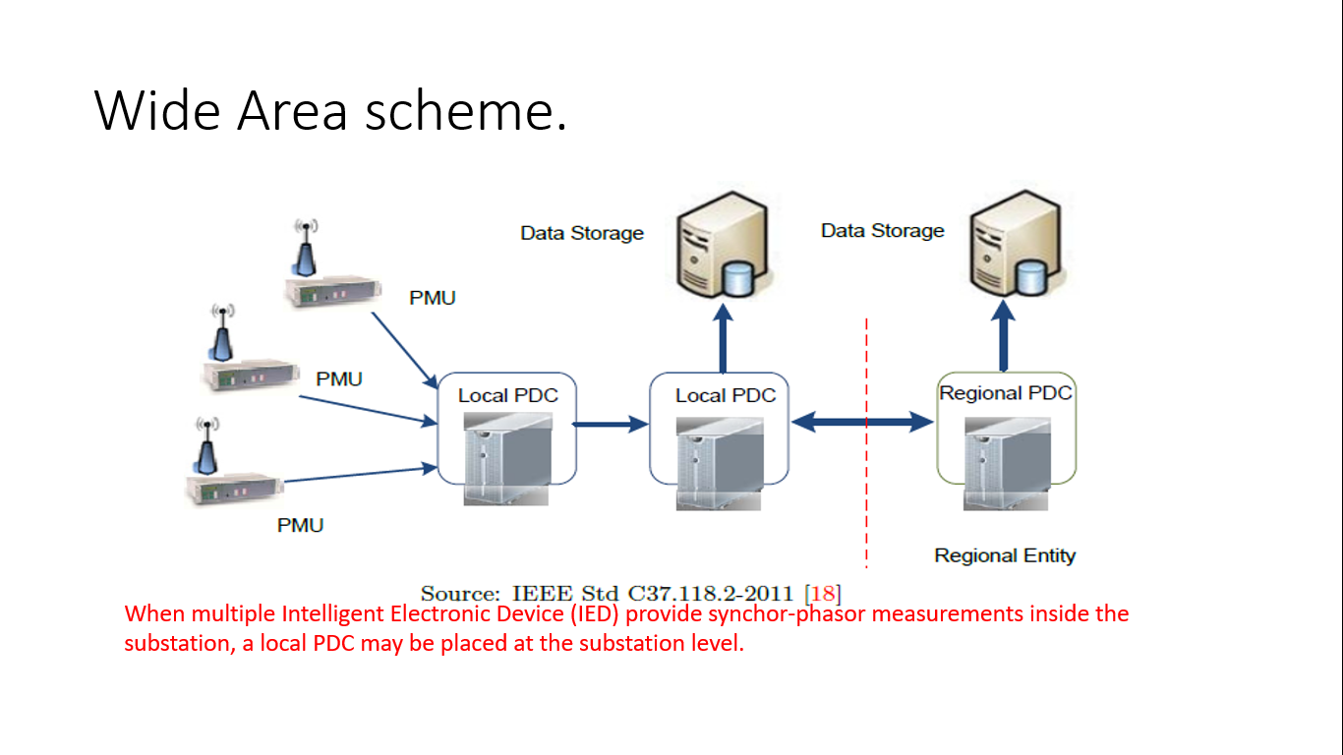
In The Same Way …

Slide 4
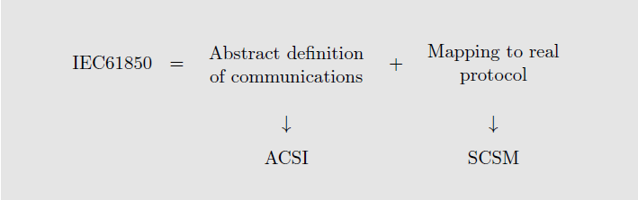
IEC 61-850 Standard
International Electrotechnical Commission's (61-850) : is an international standard defining communication protocols for intelligent electronic devices (IEDS) at electrical substations . The abstract data models defined in IEC 61850 can be mapped to a number of protocols. Current mappings in the standard are to MMS (Manufacturing Message Specification), GOOSE (Generic Object Oriented Substation Event), SMV (Sampled Measured Values), and soon to Web Services. These protocols can run over TCP/IP networks or substation LANs using high speed switched Ethernet to obtain the necessary response times below four milliseconds for protective relaying.

Slide 5
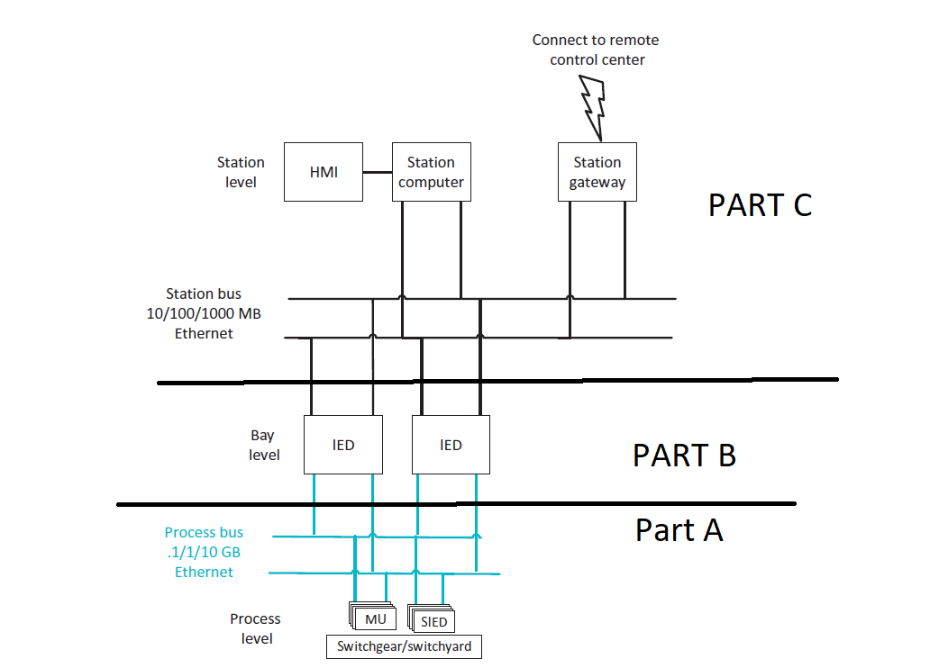
IEC 61-850 In Side Substation

Slide 6
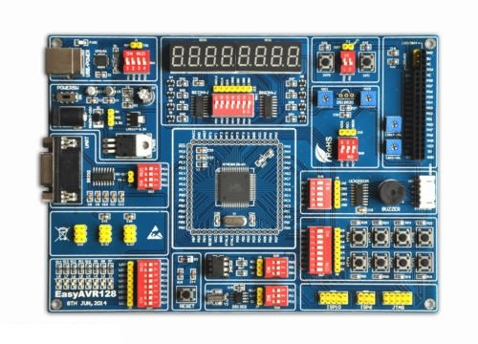
HOW We Implementation IEC61-850 Standard in our Project ?
our project consist of IEDS Which have different Function , however Just Two micro controller (at mega 128) act as Pmu which programmed To Receive Data From current sensors and voltage transformer , Then transfer This measurement To Samples Value Which Schynrozied by universal time constant which produced synchro-phsor data .(real Time data ) .
Atmega 128 micro controller

Slide 7
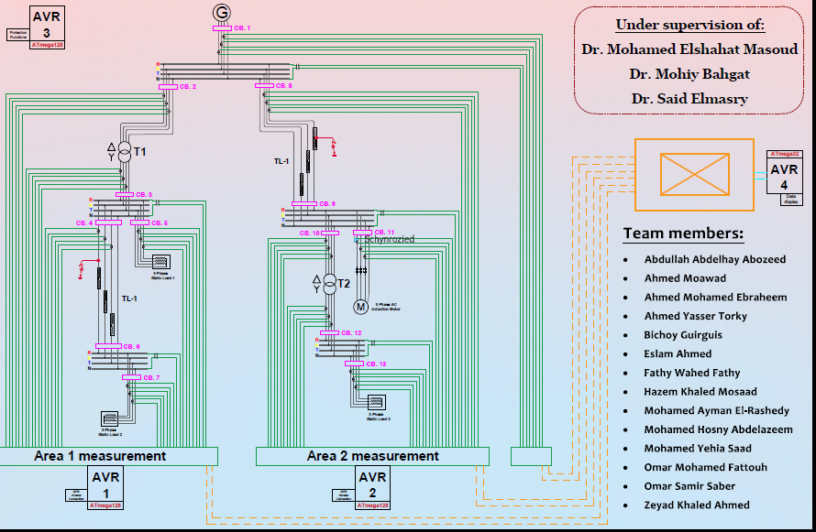

Slide 8
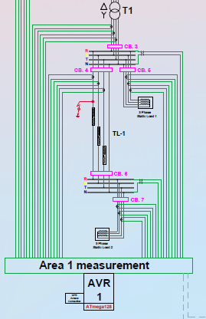
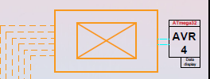
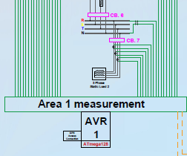
PMU of Area 1
As show in fig The AVR(1) act as Pmu which Receive
Data and Send synchrophsor Value To PDC Via Ethernet connection
PDC
Direct connection of C.S and V.T

Slide 9
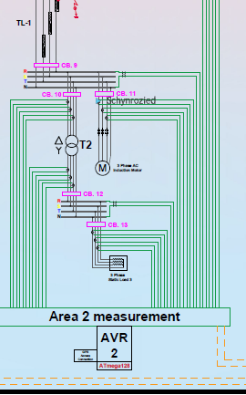
PMU Of Area (2)
The AVR(2) act as pmu which send syncro-phsor data via protocol of standard 61-850-90-50
AND IT Will Presented BY :
Abdullah Abdelhai
Bichoy Gurigus

